Slide 1


Capstone Project
University Rankings
Notes:
Hi everyone,
My name is Shiraj Ahmad,
and I'm a mentor here for data science.
In this session, I'll be explaining Power BI's Capstone Project: University Ranking.
First, congratulations on completing Excel, SQL, and Power BI.
After completing this Capstone Project, you'll be job-ready!
So, let's get started.

Slide 2
Overview
The "university rankings" dataset includes information on universities from various countries and their rankings based on three different ranking systems:
It contains data on countries represented, ranked universities, criteria used, and measurements such as student numbers and student-to-staff ratio. The main table, university_ranking_year, has scores and criteria for each university per year, enabling analysis of university performance across rankings over time.
There are a few hundred universities in the sample data, and 21 different ranking criteria across three different systems. The data exists for the years 2005 to 2016.
Notes:
Let get an overview of the dataset.
In the dataset we have information on universities various countries and their ranking based on three ranking system.
It also contains data on countries represented ranked universities, criteria used and values like no of students and student staff ratio.
The master table university_ranking_year has scores and criteria for each universities per year enabling analysis of university performance across ranking over time.

Slide 3

Problem Statement
Objective
Analysis Scope
Goal
Insights & Recommendations.
Report & Presentation
Notes:
Problem Statement
University rankings are a popular way to compare the quality of different institutions of higher education. However, there are a number of problems with these rankings, including variations across systems, key factors influencing rankings, historical trends, and the impact of limitations and biases on rankings.
The objective of this project is to conduct an exhaustive analysis of the university rankings dataset in order to explore patterns, trends, and factors influencing university rankings across different ranking systems. The goal is to provide insights that can be used to enhance the quality and competitiveness of higher education institutions worldwide.
The project will involve the following tasks:
Performing a comprehensive analysis of university rankings, including variations across systems, key factors influencing rankings, historical trends, and the impact of limitations and biases on rankings.
Deriving meaningful conclusions and recommendations for improving ranking methodologies.
Compiling analysis results, conclusions, and recommendations for stakeholders.
The success of the project will be measured by the following metrics:
The quality of the analysis
The relevance of the insights
The impact of the recommendations
This project is significant because it has the potential to improve the quality and competitiveness of higher education institutions worldwide. By understanding the factors that influence university rankings, institutions can better position themselves to succeed in the global marketplace.
Let's understand significance in detail.

Slide 4


Significance
Valuable insights
Improvement focus
Evaluation of effectiveness
Trend identification
Comprehensive understanding
Notes:
University rankings analysis can provide valuable insights for prospective students, researchers, and academic institutions to make informed decisions.
By understanding the factors that influence university rankings, individuals and institutions can make better choices about where to study or work.
Understanding ranking criteria can help institutions identify areas for improvement.
By understanding what is important to ranking organizations, institutions can focus their efforts on those areas to improve their ranking.
Analysis of university rankings can allow policymakers to assess the effectiveness of ranking systems.
By understanding how rankings are calculated, policymakers can make sure that they are fair and accurate.
Historical analysis of university rankings can identify trends for benchmarking and strategic planning in higher education.
By understanding how rankings have changed over time, institutions can identify areas where they need to improve to stay competitive.
Analysis of university rankings can enable comparisons between institutions and data-driven decisions for improving higher education quality and competitiveness.
By comparing different institutions, institutions can identify the best practices that can be adopted to improve their own performance.

Slide 5
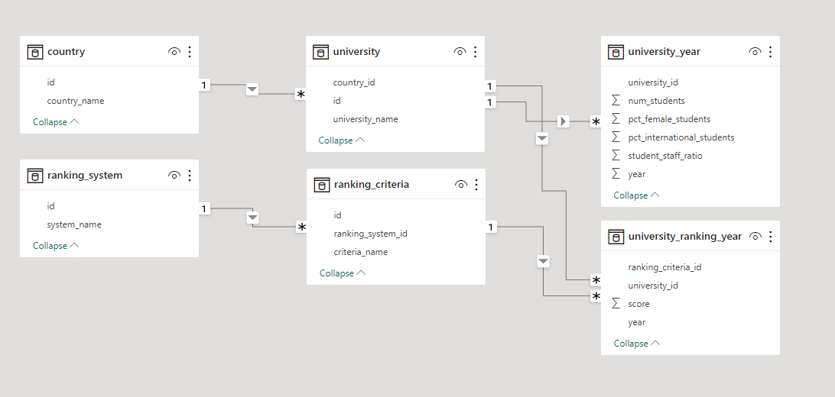
ER Diagram
Notes:
Now that we have comprehended the problem statement and recognized the significance of the project, let's delve into a thorough understanding of the dataset.
The Entity-Relationship (ER) diagram for the Power BI Dashboard using the above database represents the relationships and interactions between various entities (tables) in the database. Here's an explanation of the ER diagram based on the provided tables:
There are 6 tables in the dataset:
Country: This table contains the names of countries, which are mapped to universities using the country_id field.
University: This table contains a list of universities, which are related to countries.
Ranking system: This table contains different ranking systems.
Ranking criteria: This table contains a list of criteria, which are mapped to ranking systems using the ranking_system_id field.
University_year: This table contains information such as the number of students, the population of female students, the population of international students, and the student-to-staff ratio for several years. This table is mapped by the University_id field.
University_ranking_year: This table contains the ranking_criteria_id from the Ranking_criteria table, the University_id from the University table, the scores for each university, and the year of scoring. The relationships between the tables are shown by the lines between the tables.
The ER diagram visually presents the structure and relationships of the database, facilitating better understanding and design of the Power BI Dashboard. It provides a clear representation of data entities and their connections, enabling effective data analysis and visualization within the Power BI Dashboard.
I trust that you now have a clear understanding of the Capstone project requirements.

